Slide 1
Struktur (bag 1)

Slide 2
Topik
Struktur
Arrays of structs
typedef
structs and fungsi
Pointer ke structs
structs dalam structs
Data Struktur dan disain modular

Slide 3
Apa itu Struktur?
Kumpulan variabel yang berelasi di bawah satu nama besar /aggregate
Dapat berisi berbagai macam tipe variabel.
Cara menggunaan Struktur:
  Definisikan Struktur
  Deklarasikan/Inisialisasikan instan Struktur
  Anggota Access dari instan Struktur

Slide 4
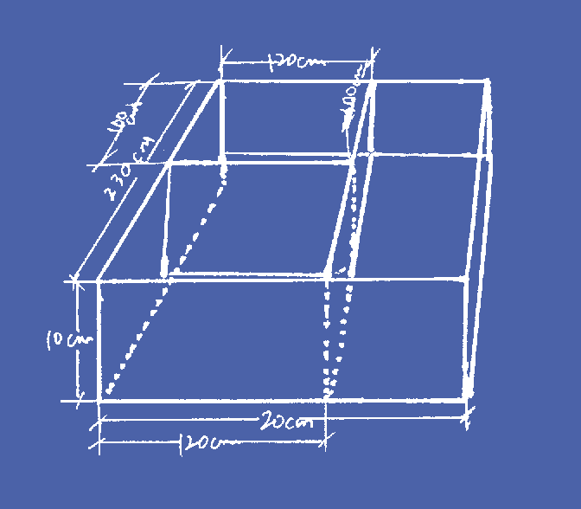
Definisi Struktur
Struktur adalah sebuah blueprint
Contoh:
Definisikan struktur dg nama “Lunchbox” yg mempunyai bagian/compartments:
fruit compartment
sandwich compartment
drink compartment
Lunchbox

Slide 5
Definisi Struktur
struct isdipakai utk menentukan blueprint
Anggota yg ditentukan tdr dr aspek yg berbeda dr struct
Contoh:
struct LunchBox
{
int fruit;
float drink;
char sandwich[MAXN];
};
Lunchbox

Slide 6


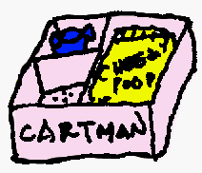

Variabel Struktur
Instan Struktur: urutan actual yg berdekatan dalam penyimpanan di lokasi memori
struct LunchBox kyle;
struct LunchBox stan, cartman, kenny;
struct LunchBox kids[5];

Slide 7
Inisialisasi variabel struct
struct LunchBox kyle = { 1, 370.0, “ham”};

Slide 8
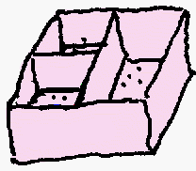
Inisialisasi variabel struct
0
1
2
3
4
struct LunchBox kids[5] =
{
{1, 370.0, “ham” },
{2, 100.0, “roast”},
{0, 0.0, “muffin”},
{1, 300.0, “salad”},
{0, 0.0, “”}
};

Slide 9
Anggota variabel struct
struct LunchBox stan, kenny;
stan.drink = 0.0;
stan.fruit = 0;
strcpy(stan.sandwich,“fruit cake”);
kenny.fruit = 1;
strcpy(kenny.sandwich, “muffin”);
kenny.drink = 300.0;

Slide 10
Anggota variabel struct
0
struct LunchBox kids[3];
int index = 1;
kids[0].drink = 300.0;
kids[0].fruit = 1;
strcpy(kids[2].sandwich, “ham”);
kids[index].fruit = 3;
1
kids[index+1].drink =
kids[index - 1].drink;
2

Slide 11
Input/Output dr struct
Library functions printf() dan scanf() tdk memiliki format conversion specifiers utk struct
Input/Output hanya utk anggota saja
struct LunchBox cartman;
scanf(“%d”, &(cartman.fruit));
scanf(“%f”, &(cartman.drink));
scanf(“%s”, cartman.sandwich);
printf(“%d, %f\n”,
cartman.fruit, cartman.drink);
printf(“%s\n”, cartman.sandwich);

Slide 12
Input/Output dr struct
struct LunchBox kids[3];
int i = 0;
for (i=0; i < 3; i++)
{
scanf(“%d %f %s”,
&(kids[i].fruit),&(kids[i].drink),
kids[i].sandwich);
}
for (i=0; i < 3; i++)
{
printf(“%d, %f, %s\n”,
kids[i].fruit, kids[i].drink,
kids[i].sandwich);
}
0
1
2

Slide 13
Contoh: Student Record
Tulis program utk membaca dan mencetak daftar nama dan nilai test student
input jumlah students
for tiap student dalam list
{
input name dan nilai
}
for tiap student dalam list
{
output name dan Nilai
}

Slide 14
Contoh tanpa struct-1
#include <stdio.h>
#include <stdlib.h>
#define MAXLEN 50
#define MAXN 20
int main()
{
char lastname[MAXN][MAXLEN];
float Nilai[MAXN];
int count = 0;
int i;
printf(“Berapa student? ");
scanf("%d", &count);
Nilais1.c

Slide 15
Contoh without struct-2
if (count > MAXN)
{
printf("Not enough space.\n");
exit(1);
}
for (i=0; i < count; i++)
{
printf(“Masukannama dan nilai ");
scanf("%s %f", lastname[i], &Nilai[i]);
}
printf("\nDaftar kelas\n\n");
for (i=0; i < count; i++)
{
printf("Nama: %s\n", lastname[i]);
printf(“Nilai: %.1f\n\n", Nilai[i]);
}
return 0;
}
Nilais1.c

Slide 16
Contoh: Student Record
Definisikan struct: StudentRec
struct StudentRec
{
char lastname[MAXLEN];
float Nilai;
};
Mudah di perluas nantinya utk di tambah dg IDNum, alamat, dst

Slide 17
Contoh dengan struct (testing)
#include <stdio.h>
#define MAXLEN 50
struct StudentRec
{
char lastname[MAXLEN];
float Nilai;
};
int main()
{
struct StudentRec studA;
struct StudentRec studB;
printf(“Masukan Nama dan Nilai utk student A: ");
scanf("%s %f", studA.lastname, &(studA.Nilai));
printf(“Masukan Nama dan Nilai utk student B: ");
scanf("%s %f", studB.lastname, &(studB.Nilai));
printf("Student A: %s\t%f\n", studA.lastname, studA.Nilai);
printf("Student B: %s\t%f\n", studB.lastname, studB.Nilai);
return 0;
}
Nilais2a.c

Slide 18
Contoh with struct-1
#include <stdio.h>
#include <stdlib.h>
#define MAXLEN 50
#define MAXN 20
struct StudentRec
{
char lastname[MAXLEN];
float Nilai;
};
int main()
{
struct StudentRec class[MAXN];
int count = 0;
int i;
printf(“Berapa students? ");
scanf("%d", &count);
Nilais3a.c

Slide 19
Contoh with struct-2
if (count > MAXN)
{
printf(“Tidak cukup ruang.\n");
exit(1);
}
for (i=0; i < count; i++)
{
printf("Masukan nama dan nilai ");
scanf("%s %f", class[i].lastname, &(class[i].Nilai));
}
printf("\nDaftar kelas\n\n");
for (i=0; i < count; i++)
{
printf("Nama: %s\n", class[i].lastname);
printf(“Nilai: %.1f\n\n", class[i].Nilai);
}
return 0;
}
Nilais3a.c

Slide 20

Kesalahan umum
struct StudentRec
{
char lastname[MAXLEN];
float Nilai;
};
Semicolon disini jangan lupa

Slide 21

Catatan struct
Inisialisasi vs. Assignment
struct StudentRec studA = {“Fermat”, 90};
struct StudentRec studA;
studA = {“Fermat”, 90};
struct StudentRec studA = {“Fermat”, 90};
struct StudentRec studB;
studB = studA; /* struct mengandung pointer? */

Slide 22
Catatan struct
Var struct tdk dpt di bandingkan
Kita hanya dpt membandingkan aggt-nya saja
if (studA == studB)
{
printf(“Duplikasi data.\n”);
}
if (strcmp(studA.lastname, studB.lastname) == 0
&& (studA.Nilai == studB.Nilai) )
{
printf(“Duplikasi data.\n”);
}

Slide 23
Catatan struct
Kita dapat mendefinisikan struct, dan mendeklarasikan instan utk struktur tsb
struct StudentRec
{
char lastname[MAXLEN];
float Nilai;
} studA, studB, class[MAXN];
Instan

Slide 24
typedef
Statement typedef membuat identifer sama dg tipe yg ditentukan
struct StudentRec
{
char lastname[MAXLEN];
float Nilai;
};
Contoh tanpa
typedef
struct StudentRec studentA;
struct StudentRec class[MAXN];

Slide 25
typedef (lanj)
Statement typedef membuat identifer sama dg tipe yg ditentukan
struct StudentRec
{
char lastname[MAXLEN];
float Nilai;
};
typedef struct StudentRec Student;
Contoh dg typedef
Student studA;
Student class[MAXN];

Slide 26
Contoh dg typedef (testing)
#include <stdio.h>
#define MAXLEN 50
struct StudentRec
{
char lastname[MAXLEN];
float Nilai;
};
typedef struct StudentRec Student;
int main()
{
Student studA;
Student studB;
printf(“Masukan Nama dan Nilai utk student A: ");
scanf("%s %f", studA.lastname, &(studA.Nilai));
printf(“Masukan Nama dan Nilai utk student B: ");
scanf("%s %f", studB.lastname, &(studB.Nilai));
printf("Student A: %s\t%f\n", studA.lastname, studA.Nilai);
printf("Student B: %s\t%f\n", studB.lastname, studB.Nilai);
return 0;
}
Nilais2b.c

Slide 27
Contoh dg typedef-1
#include <stdio.h>
#include <stdlib.h>
#define MAXLEN 50
#define MAXN 20
struct StudentRec
{
char lastname[MAXLEN];
float Nilai;
};
typedef struct StudentRec Student;
int main()
{
int count = 0;
Student class[MAXN];
int i;
printf(“Berapa students? ");
scanf("%d", &count);
Nilais3b.c

Slide 28
Contoh with typedef-2
if (count > MAXN)
{
printf("Not enough space.\n");
exit(1);
}
for (i=0; i < count; i++)
{
printf("Masukan nama dan nilai ");
scanf("%s %f", class[i].lastname, &(class[i].Nilai) );
}
printf("\nDaftar kelas\n\n");
for (i=0; i < count; i++)
{
printf("Nama: %s\n", class[i].lastname);
printf(" Nilai: %.1f\n\n", class[i].Nilai);
}
return 0;
}
Nilais3b.c

Slide 29
Catatan typedef
Cara lain menggunakan typedef:
typedef struct
{
char lastname[MAXLEN];
float Nilai;
} Student;
Student studA, studB;
Student class[MAXN];

Slide 30
Mengirim struct ke Function
S[pt biasa, parameter formal di kopi ke aktual parameter
void printRecord ( Student item )
{
printf("Nama: %s\n", item.lastname);
printf(“Nilai: %.1f\n\n", item.Nilai);
}
main()
{
Student studentA = {“Gauss”, 99.0};
printRecord(studentA);
}

Slide 31
Function yg mengembalikan suatu struct
“paket” yg berisi beberapa nilai
Student readRecord ( void )
{
Student newStudent;
printf("Masukan nama dan nilai ");
scanf("%s %f",newStudent.lastname,&(newStudent.Nilai));
return newStudent;
}
Version 1
main()
{
Student studentA;
studentA = readRecord();
}

Slide 32
Function yg mengembalikan suatu struct
“paket” yg berisi beberapa nilai
Student readRecord ( Student newStudent )
{
printf("Masukan nama dan nilai ");
scanf("%s %f",newStudent.lastname,&(newStudent.Nilai));
return newStudent;
}
Version 2
main()
{
Student studentA;
studentA = readRecord(studentA);
}

Slide 33
Contoh: Structs dan Function-1
#include <stdio.h>
#include <stdlib.h>
#define MAXLEN 50
#define MAXN 20
struct StudentRec
{
char lastname[MAXLEN];
float Nilai;
};
typedef struct StudentRec Student;
Student readRecord ( void )
{
Student newStudent;
printf("Masukan nama dan nilai ");
scanf("%s %f", newStudent.lastname, &(newStudent.Nilai));
return newStudent;
}
void printRecord ( Student item )
{
printf("Nama: %s\n", item.lastname);
printf(“Nilai: %.1f\n\n", item.Nilai);
}
Nilais4a.c

Slide 34
Contoh: Structs dan Function-2
int main()
{
int count = 0;
Student class[MAXN];
int i;
printf(“Berapa students? ");
scanf("%d", &count);
if (count > MAXN)
{
printf(“Tidak cukup ruang.\n");
exit(1);
}
for (i=0; i < count; i++)
{
class[i] = readRecord();
}
printf("\nDaftar kelas\n\n");
for (i=0; i < count; i++)
{
printRecord(class[i]);
}
return 0;
}
Nilais4a.c

